Slide 1
Informed search algorithms
Main reference:
Chapters 3 of Russell, S., & Norvig, P. (2016). Artificial intelligence: a modern approach.

Slide 2












Uninformed vs informed strategy
Uninformed
(blind)
Informed
(roughly see/know how far each way is to your destination)

Slide 3















Evaluation function f(n)
f(n) is a cost estimate for node n.
(Cost to reach the goal if the agent goes though node n.)
For example, cost estimate of going from HCM to An Giang can be

Slide 4

Idea of an informed search strategy
A node is selected for expansion based on an evaluation function, f(n).

Slide 5
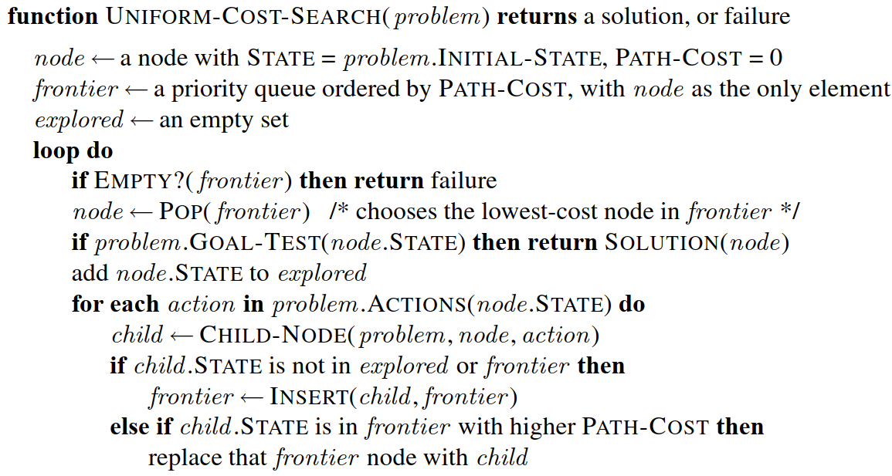




Slide 6
Different choices of f(n) lead to different informed search algorithms.

Slide 7




Best-ﬁrst search
f(n) = h(n)
Heuristic function h(n) estimates cost of the path from node n to the goal.
For example,

Slide 8
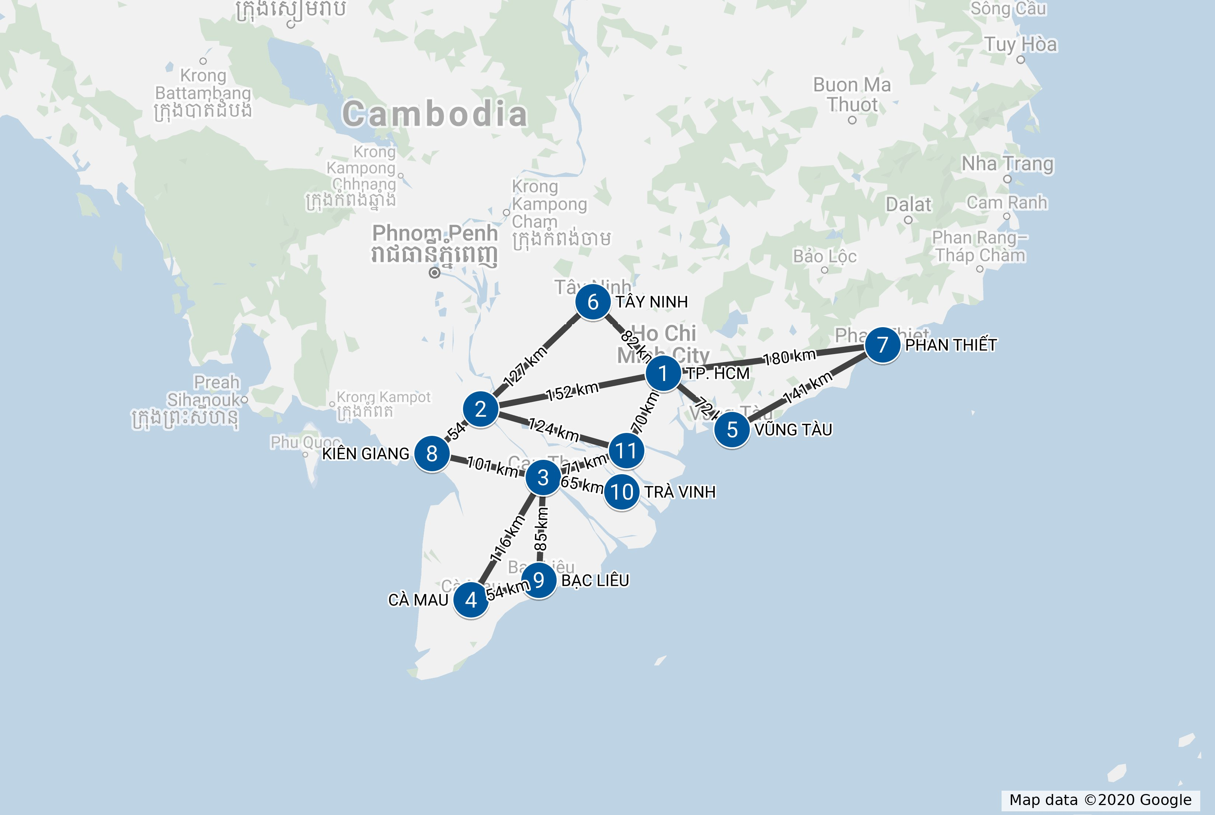















AN GIANG
BẾN TRE

Slide 9









































Uninformed
(Depth-first search)
Informed
(Best-first search)

Slide 10




















Best-first search is NOT optimal
AN GIANG
BẾN TRE

Slide 11










Best-first search is NOT optimal due to
AN GIANG
BẾN TRE

Slide 12
A* search
f(n) = n.PATH-COST + h(n)

Slide 13















A* search demo
AN GIANG
BẾN TRE

Slide 14
A∗ search is both complete and optimal*

Slide 15



















A consistent heuristic satisfies
h(n) ≤ cost(n, n’) + h(n’), for every node n and its successor n’
AN GIANG
BẾN TRE

Slide 16


















Example of an inconsistent heuristic
AN GIANG
BẾN TRE

Slide 17

A note on A* search
A* can be considered as an improved version of Uniform-cost search,
which is a variant of breadth-first search.

Slide 18
HEURISTIC FUNCTIONS COMPARISON

Slide 19







0 heuristic vs. accurate heuristic
If h(n) = 0 for all n, then f(n) = n.PATH-COST ➔
With a consistent heuristic close to actual cost, A* can find optimal solution
Breadth-first search
A* search
Animation by Wikipedia/Subh83
Notes:
https://commons.wikimedia.org/wiki/File:Dijkstras_progress_animation.gif
https://commons.wikimedia.org/wiki/File:Astar_progress_animation.gif

Slide 20
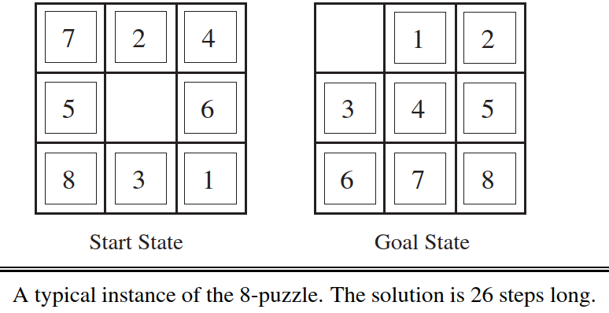

Consider heuristics for the 8-puzzle
Source: (Russell, 2016)

Slide 21


















Two heuristics for the 8-puzzle
h₁ = the number of misplaced tiles.
h₂ = the sum of the distances of the tiles from their goal positions.
Note: tiles cannot move along diagonals ➔ city block distance

Slide 22
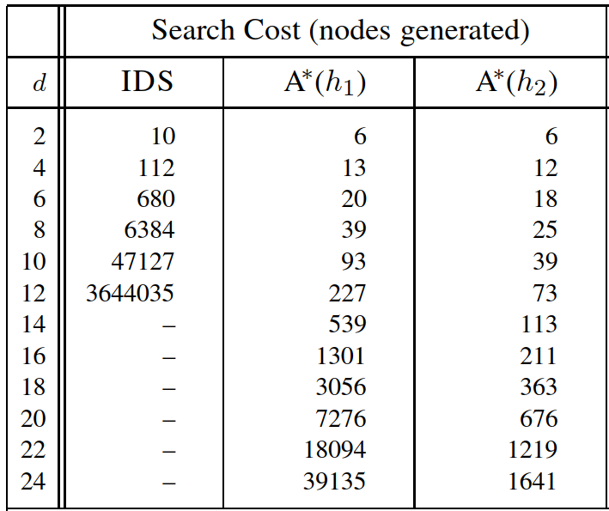
Effect of heuristic accuracy
Source: (Russell, 2016)

Slide 23
GENERATING HEURISTIC FUNCTIONS

Slide 24
To generate heuristic functions
Method 1. Using relaxed problems
Method 2. Using pattern databases

Slide 25









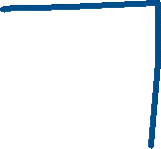



Relaxed problems
A relaxed problem: A problem with fewer restrictions on the actions.
For example, the 8-puzzle actions are described as
A tile can move from square A to square B if A is horizontally or vertically adjacent to B and B is blank.
Three relaxed problems:
(a)
(b)
(c)

Slide 26
From consistent heuristics h₁...h_{m}, the best heuristic is
h(n) = max{ h₁(n), …, h_{m}(n) }

Slide 27


Pattern databases
1. Choose a subproblem.
For example,
2. Construct the pattern database: store solution costs for every instances of the subproblem.

Slide 28










Notes:
The database is constructed by searching back from the goal and recording the cost of each new pattern encountered.
We could also construct databases for other subproblems,

